Slide 1

Department of Computer Engineering and Technology Mid Term Review Project Presentation on “IoT ASSISTED FOOD DONATION AND WASTE MANAGEMENT SYSTEM” Domain of Project: IOT (In-House Project)
Project Guide
Dr. Vinayak Musale
Assistant Professor
Dept. of CET
MIT WPU, Pune
Avinash Shelukar (103221997)
Ruchik Alhat (1032202149)
Pruthu Prabhudesai (1032212257)
Fahad Malik (1032200260)

Slide 2
Problem Statement
To develop an innovative IoT system that can track, manage, and optimize food donation and waste management processes.

Slide 3
Literature Survey
Sr No | Publication Title | Publication Year | Positive Points Of Publication | Gaps In Publication Work
1 | Food Waste Management System (Journal) | 2022 | Awareness of the Issue. Mention of Sustainability. | Specific Data and Case Studies. Innovative Waste Management Solutions
2 | Food Waste Management Using Android (Journal) | 2022 | Hunger Alleviation, User-friendly interface | Limited Coverage, Privacy and Security Concerns
3 | Waste Food Management And Donation App (Conference Paper) | 2022 | Donor-Volunteer Connection, Feedback and ratings. | Scalability, Integration of payment system.
4 | Review on food quality assessment using machine learning and electronic nose system | 2023 | Innovative Approach, Rapid and non destructive. | Limited Adoption, Data dependent
5 | Smart eNose Food Waste Management System | 2021 | Innovative use of IOT, Low Cost Sensors, Better Environmental Impact. | Data security and calibration challenges.

Slide 4
Research Gap
1) Smart eNose Food Waste Management System: While the proposed system offers a novel approach to detecting food wastage using IoT, its success heavily depends on the accurate calibration and functioning of sensors. Sensor malfunctions or inaccuracies could lead to misleading data and inefficiencies in food waste management.
2) Food Waste Management Using Android : The mobile app primarily relies on users active participation in food donation. In cases where potential donors are not proactive or do not have the app installed, the effectiveness of reducing food waste is limited.
3) The current system often requires physical exchange and manual coordination between food donors and NGOs or support groups. This process can be inefficient, particularly when it comes to collecting leftover food promptly.
4) Review on food quality assessment using machine learning and electronic nose system: One potential drawback is the reliance on machine learning algorithms, which can be sensitive to the quality and representativeness of the training data, potentially leading to inaccurate food quality assessments.
5) Review on food quality assessment using machine learning and electronic nose system: One potential limitation of this system is its reliance on low-cost sensors, such as MQ4 and MQ135. These sensors, while budget-friendly, may not consistently provide highly accurate measurements, which could lead to inaccuracies in detecting gas emissions from different food items. This could result in incorrect predictions and potentially reduce the system's effectiveness in minimizing food waste.

Slide 5
Software/Hardware Requirements
Software Requirement:
Operating System (Windows 11)
REACT Js
Database
Node JS
Express
MongoDB
Hardware Requirement:
1. NodeMCu- ESP8266
2. Temperature Sensor - K Thermocouple Using MAX 6675
3. Gas Sensor: MQ4
4. Jumper Wires

Slide 6
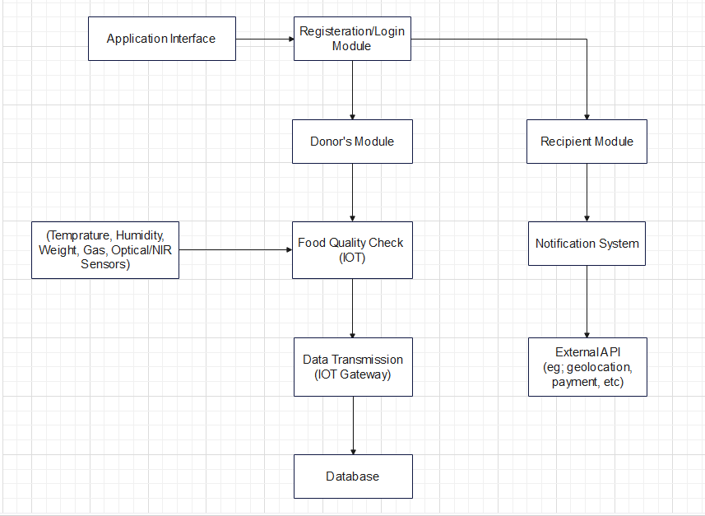
Block Diagram:

Slide 7
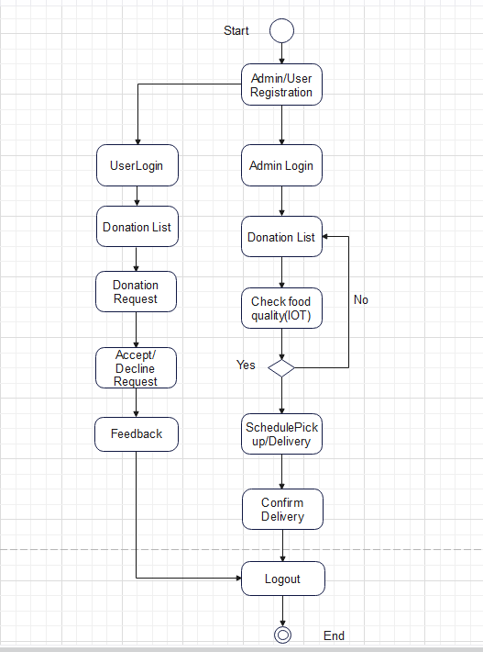
UML Diagrams
Use case Diagram

Slide 8
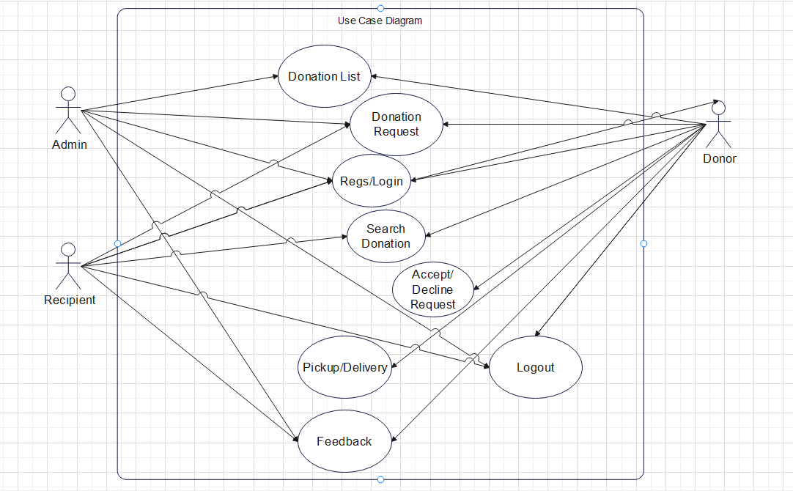
Activity Diagram:

Slide 9
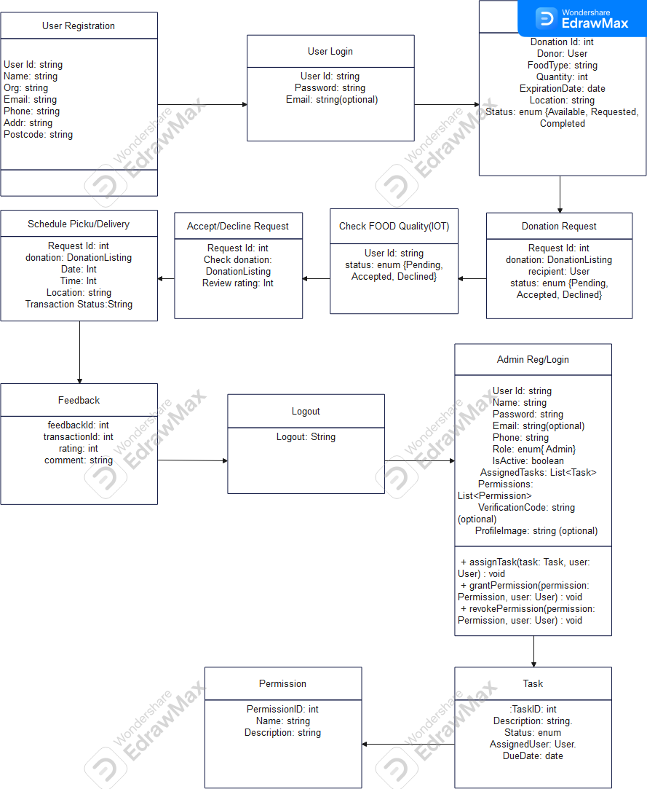
Class Diagram :

Slide 10
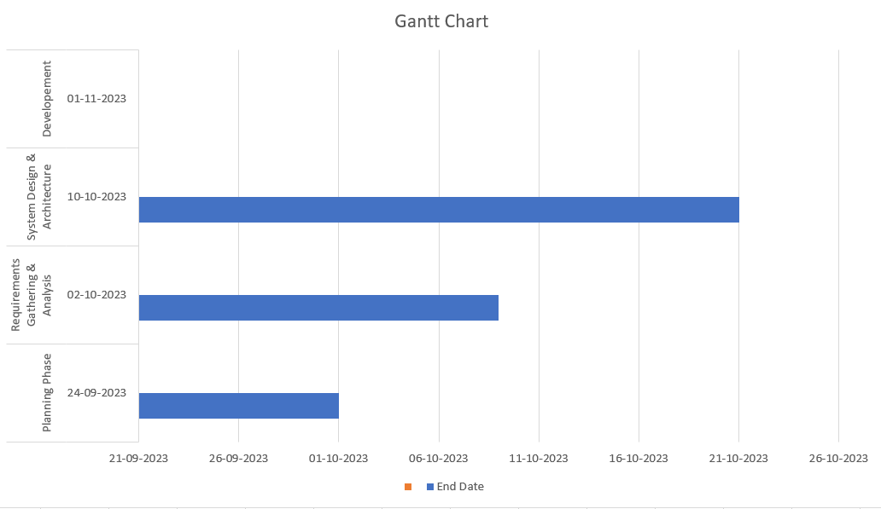
Project Timeline Diagram
LOREM

Slide 11
Future Aspects
Project Initiation:
Define the project scope, objectives, and key performance indicators (KPIs).
Assemble a project team with the necessary skills in IoT, data analytics, software development, and food management.
Research and Requirements Gathering:
Conduct a comprehensive review of existing IoT and food waste management solutions.
Engage with potential users, such as food donors, recipients, and waste management authorities, to understand their specific needs and challenges.
System Design:
Design the architecture of the IoT system, including hardware components, data collection methods, and communication protocols.
Develop the user interface for both donors and recipients, ensuring a user-friendly experience.
Hardware and Sensor Integration:
Procure or develop IoT sensors for monitoring food items, storage conditions, and environmental factors.
Integrate these sensors with the system to enable real-time data collection.

Slide 12
Data Analytics and Machine Learning:
Develop algorithms for predictive analytics, including food surplus identification and waste reduction strategies.
Implement machine learning models to match surplus food with appropriate recipients and provide recommendations.
Safety and Quality Assurance:
Implement safety checks and alerts based on sensor data to ensure food safety.
Develop quality assurance protocols to maintain food quality during transportation and storage.
Development and Testing:
Build the IoT system and associated software applications.
Conduct extensive testing to validate system functionality, security, and performance.

Slide 13
References
https://www.irjmets.com/uploadedfiles/paper/issue_5_may_2022/23732/final/fin_irjmets1653110054.pdf
https://www.irjmets.com/uploadedfiles/paper/issue_11_november_2022/31499/final/fin_irjmets1669124885.pdf
http://ijariie.com/AdminUploadPdf/Waste_Food_Management_and_Donation_App_ijariie17203.pdf
https://www.sciencedirect.com/science/article/pii/S2590137023000626
https://www.hindawi.com/journals/js/2021/9931228/

Slide 14



